Slide 1
QKV
ICML 2026
Do Transformers Need
Three Projections?
A Systematic Study of QKV Projection-Sharing Variants
50% KV cache reduction
Only +3.1% perplexity
Stacks with GQA / MQA
Ali Kayyam · Anusha Madan Gopal · M. Anthony Lewis
BrainChip Inc., Laguna Hills, CA, USA

Slide 2
MOTIVATION
Why three projections?
Every attention head learns three separate linear maps of each token — Query, Key, Value. This redundancy is rarely questioned.
Q=K-V
symmetric maps
Share Query & Key
CNNs, RNNs & State-Space Models use unified internal representations. Transformers keep three. Is the tripartite design actually necessary?
Q-K=V
our key result
Share Key & Value
Q=K=V
most aggressive
One projection for all

Slide 3
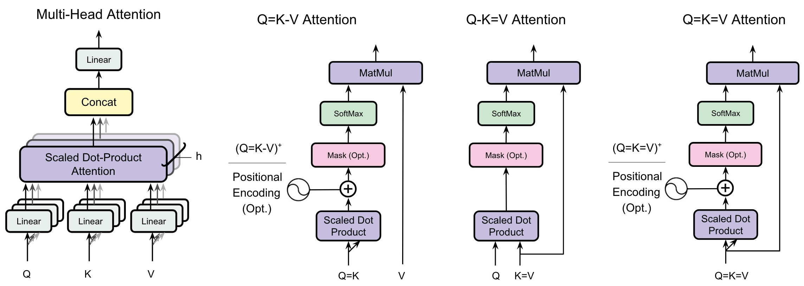
APPROACH
Projection-shared attention variants
Same core attention — we only constrain which projections are tied. (X)⁺ variants add 2D positional encoding to restore directional asymmetry on non-causal tasks.

Slide 4


KEY IDEA
Projection sharing is a new, orthogonal axis
Head Sharing
Projection Sharing
GQA / MQA — PRIOR WORK
+
THIS WORK
Reduce the number of KV heads in a layer.
Tie the K and V projection matrices (K = V).
MULTIPLY THE GAINS
Because the two operate on different dimensions, they stack.
75%
GQA-4
cache reduction
87.5%
Q-GQA-4
cache reduction
96.9%
Q-MQA
cache reduction

Slide 5
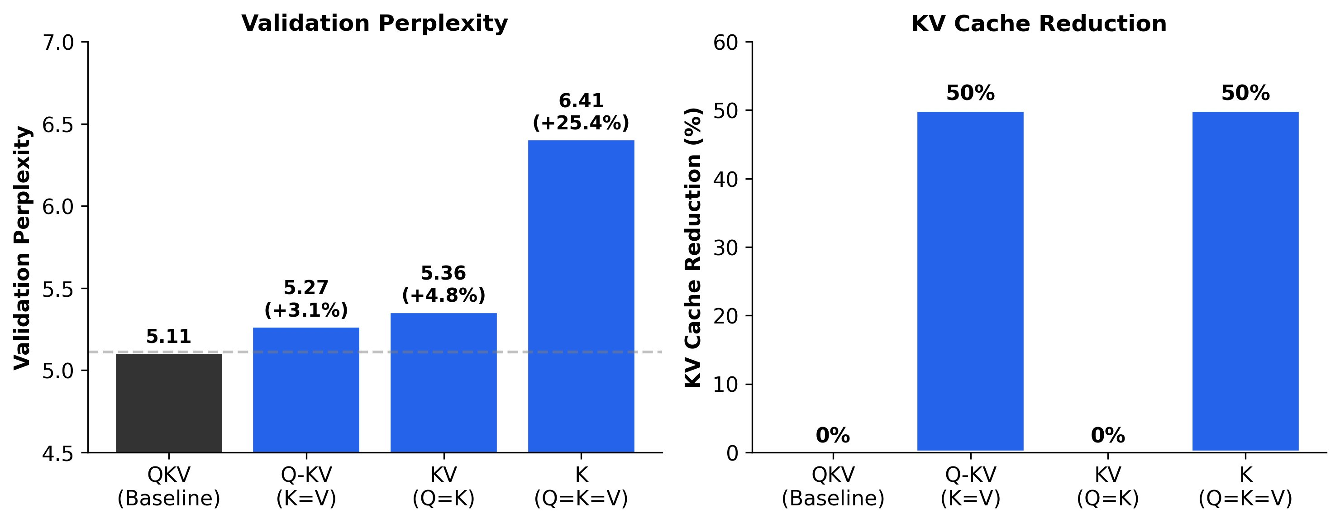
RESULTS · LANGUAGE MODELING
Q-K=V is the winning projection variant
+3.1%
perplexity cost of Q-K=V
vs. QKV baseline (5.27 vs 5.11)
50%
KV cache reduction
store K only, reuse it as V
300M params · 10B tokens · SlimPajama
+25.4%
Q=K=V collapses
single projection too restrictive

Slide 6


INSIGHT
Why Q-K=V works — and Q=K-V doesn't
Q-K=V preserves quality
Q=K-V breaks directionality
Keys & Values share representational space — but attention QKᵀ stays asymmetric.
Forcing Q = K makes the attention map symmetric (KKᵀ), destroying the causal directionality language modeling needs.
Evidence from trained QKV models:
K–V cosine similarity 0.73 — highly redundant
Similar effective rank (687 vs 702 / 1024)
Q stays distinct: cos(Q,K)=0.42, cos(Q,V)=0.31
And it gives nothing back:
+4.9% perplexity degradation
Zero cache benefit — still caches K and V
Q=K=V inherits both flaws → +25.4%

Slide 7
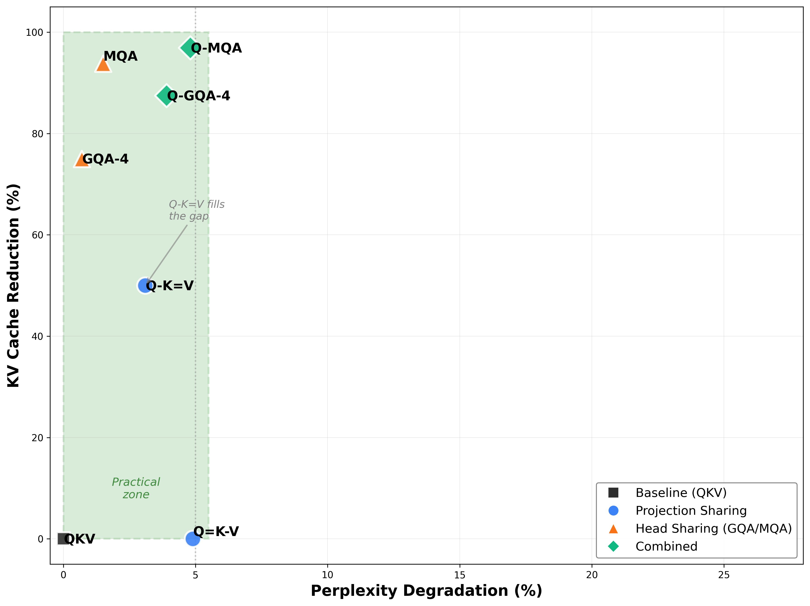
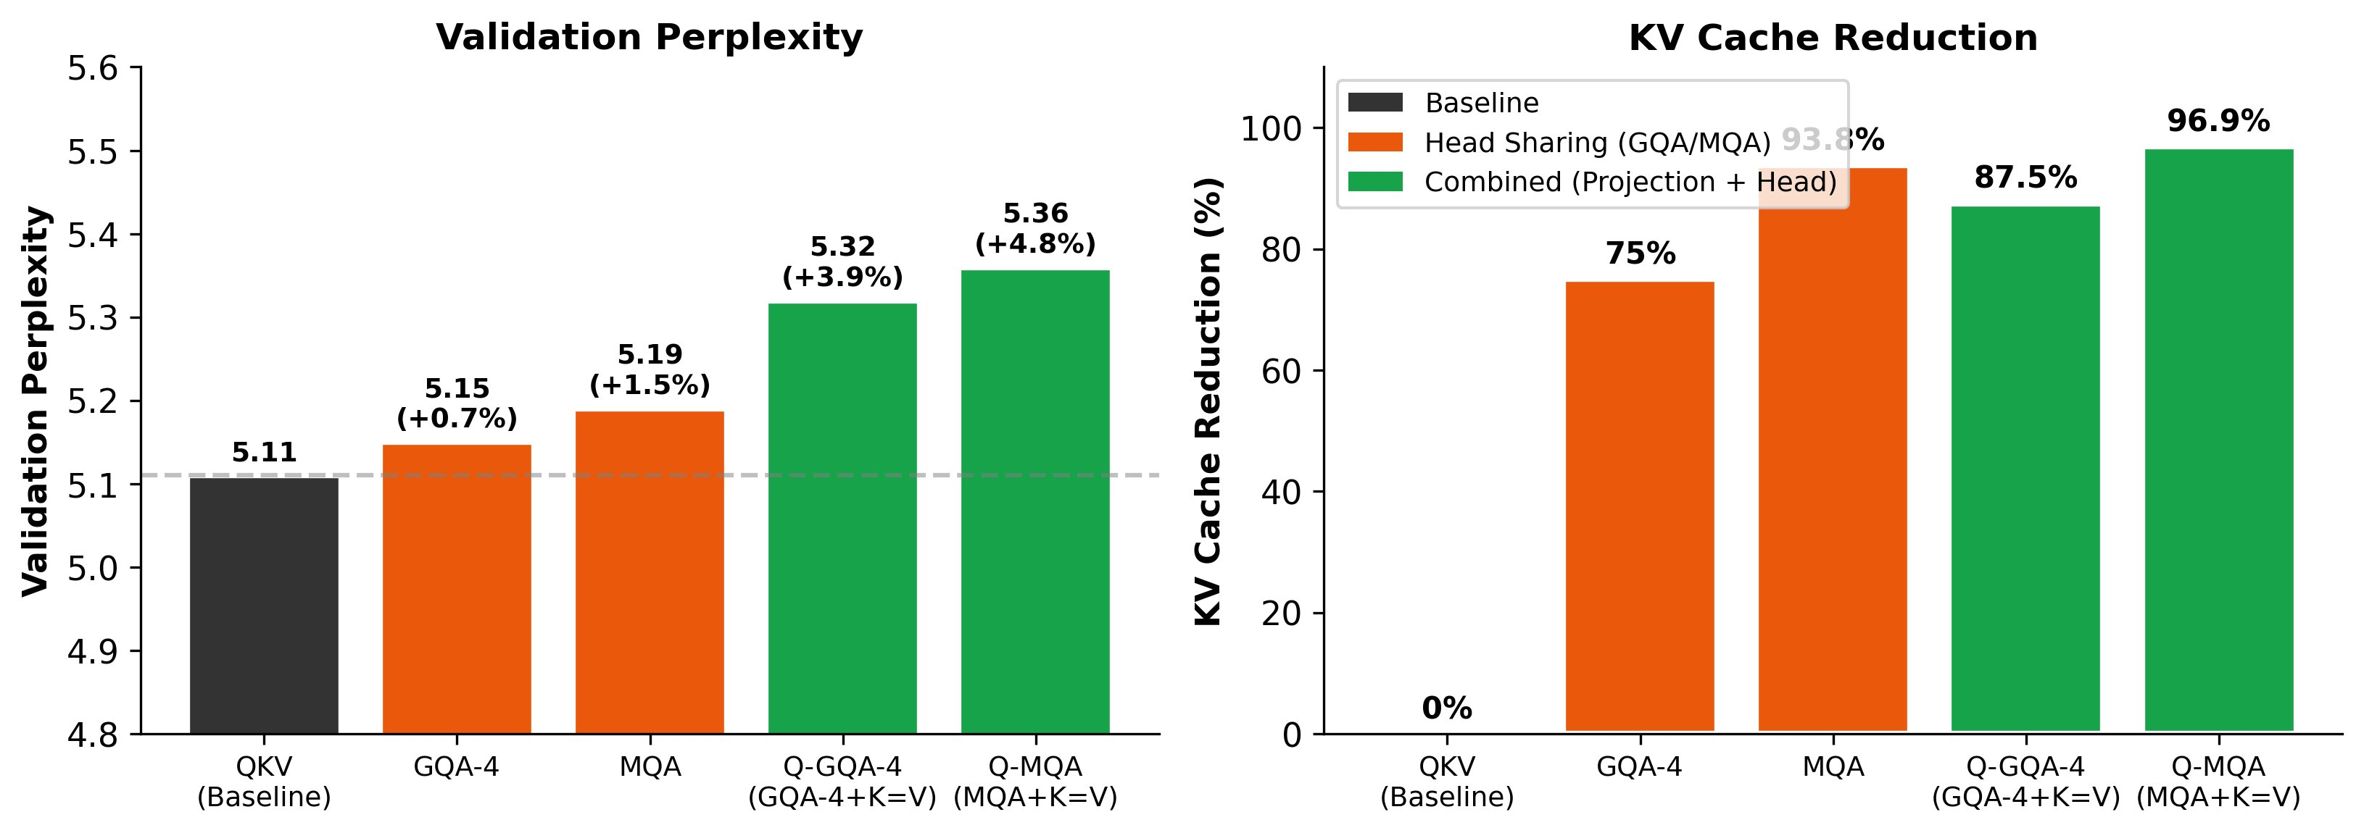
RESULTS · SYNERGY
Stacking pushes the efficiency frontier
Projection sharing fills the gap between the QKV baseline and head-sharing methods — then combines with them.
Q-MQA → 96.9% cache cut at <5% quality loss
All variants converge cleanly — no training instabilities, no special initialization.

Slide 8
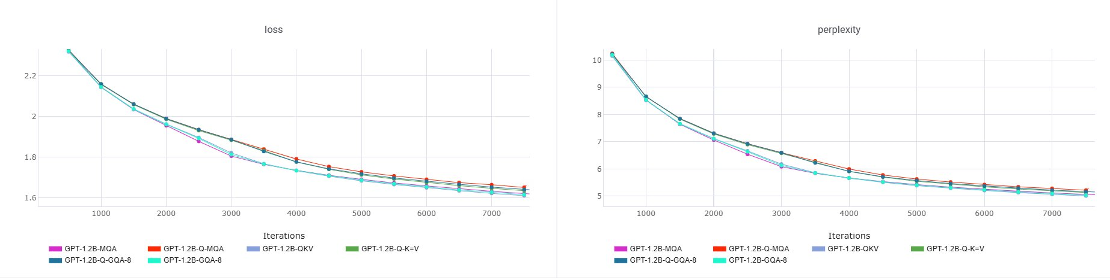
RESULTS · SCALE & GENERALITY
Holds at 1.2B and on downstream tasks
1.2B PARAMETERS — VALIDATION
5-SHOT DOWNSTREAM ACCURACY (1.2B)
Model | Avg Acc | Cache ↓
QKV (baseline) | 36.40 | —
Q-K=V | 35.99 | 50%
GQA-8 | 35.86 | 75%
Q-GQA-8 | 36.72 | 87.5%
Q-MQA | 34.38 | 96.9%
Relative rankings stay consistent from 300M → 1.2B. Q-K=V degradation actually shrinks (3.1% → 2.48%).
Perplexity ≠ capability. Q-K=V trails QKV by 2.48% perplexity but only 0.41% downstream accuracy — while halving the cache.

Slide 9



TAKEAWAYS · DEPLOYMENT
Which variant, when?
Cloud — quality first
+0.7%
perplexity
75%
cache ↓
GQA-4
Edge — balanced
+3.1%
perplexity
50%
cache ↓
Q-K=V
Edge — aggressive
+3.9%
perplexity
87.5%
cache ↓
Q-GQA-4
IoT / Mobile
+4.8%
perplexity
96.9%
cache ↓
Q-MQA
Projection sharing is a free, stackable knob — choose how far down the cache you go.

Slide 10
CONCLUSION
Transformers don't need three projections.
K = V is enough
Tying Key & Value gives 50% KV-cache reduction with only +3.1% (300M) / +2.48% (1.2B) perplexity.
Asymmetry is what matters
Quality needs Q distinct from a shared K-V — not three independent projections. Q=K breaks it.
Orthogonal to head sharing
Stacks with GQA/MQA: up to 96.9% cache reduction, enabling practical billion-parameter edge inference.
Code: github.com/anushamadan02/Do-Transformers-Need-3-Projections

